Slide 1
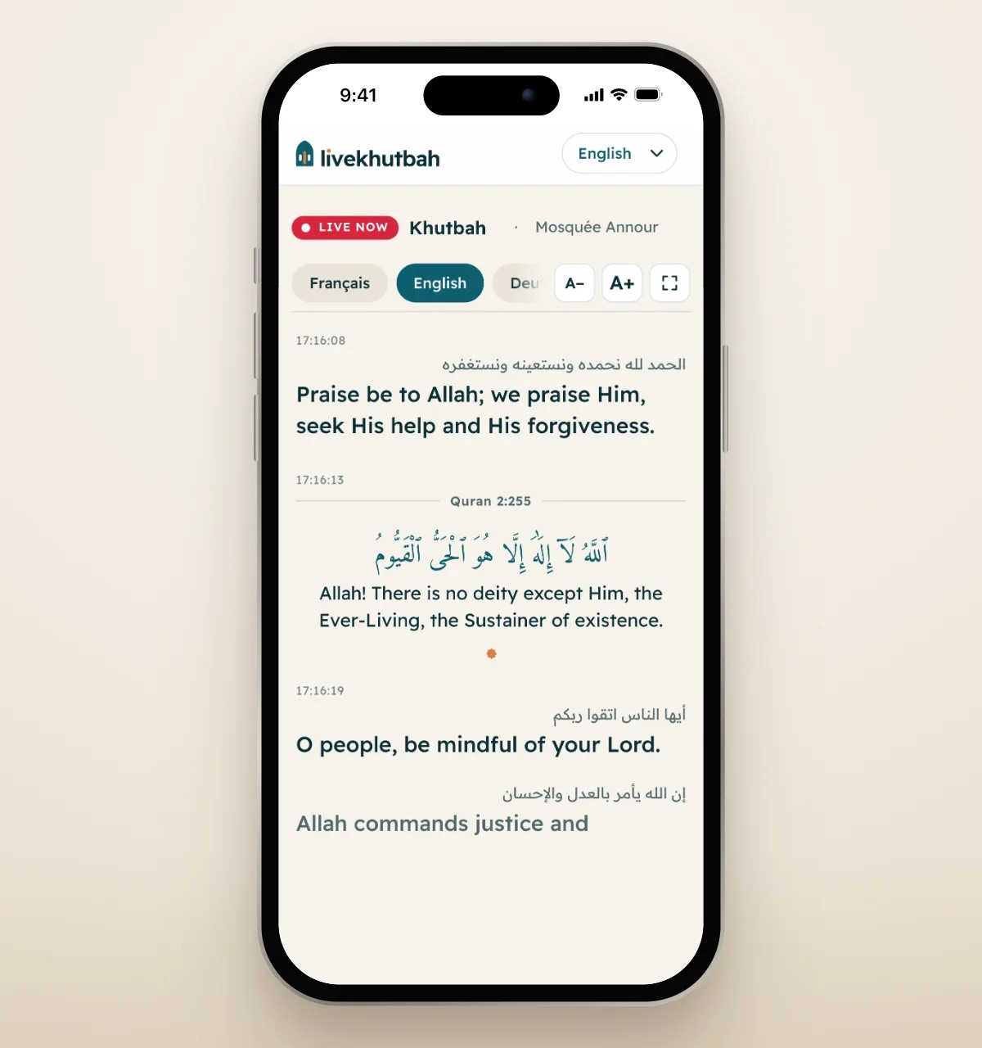

Khutbahs, lessons and talks, translated live
The speaker talks. Everyone in the room reads along on their own phone, in their own language. From any language into 100+.
livekhutbah.com

Slide 2
THE CHALLENGE
Not everyone in the room understands what is said
Language divides the room
Converts, visitors, students and young people who grew up abroad miss the heart of the message when it is only in Arabic or one other language.
Interpreters and headsets don’t scale
A volunteer interpreter is hard to find every week, headset systems are expensive, and both cover one or two languages at most.
Deaf and hard‑of‑hearing people are left out
Without live text of what is said, they cannot follow at all.
LiveKhutbah removes that barrier, every week, in every language in the room.
livekhutbah.com
2

Slide 3
WHAT IT IS
Every word, in their language, as it is said
A phone near the speaker listens. LiveKhutbah writes down what is said and translates it sentence by sentence. People scan a QR code and read along on their own phone, or on a TV in the room.
100+
Live
0
No limit
languages
word by word
apps to install
on listeners
livekhutbah.com
3

Slide 4
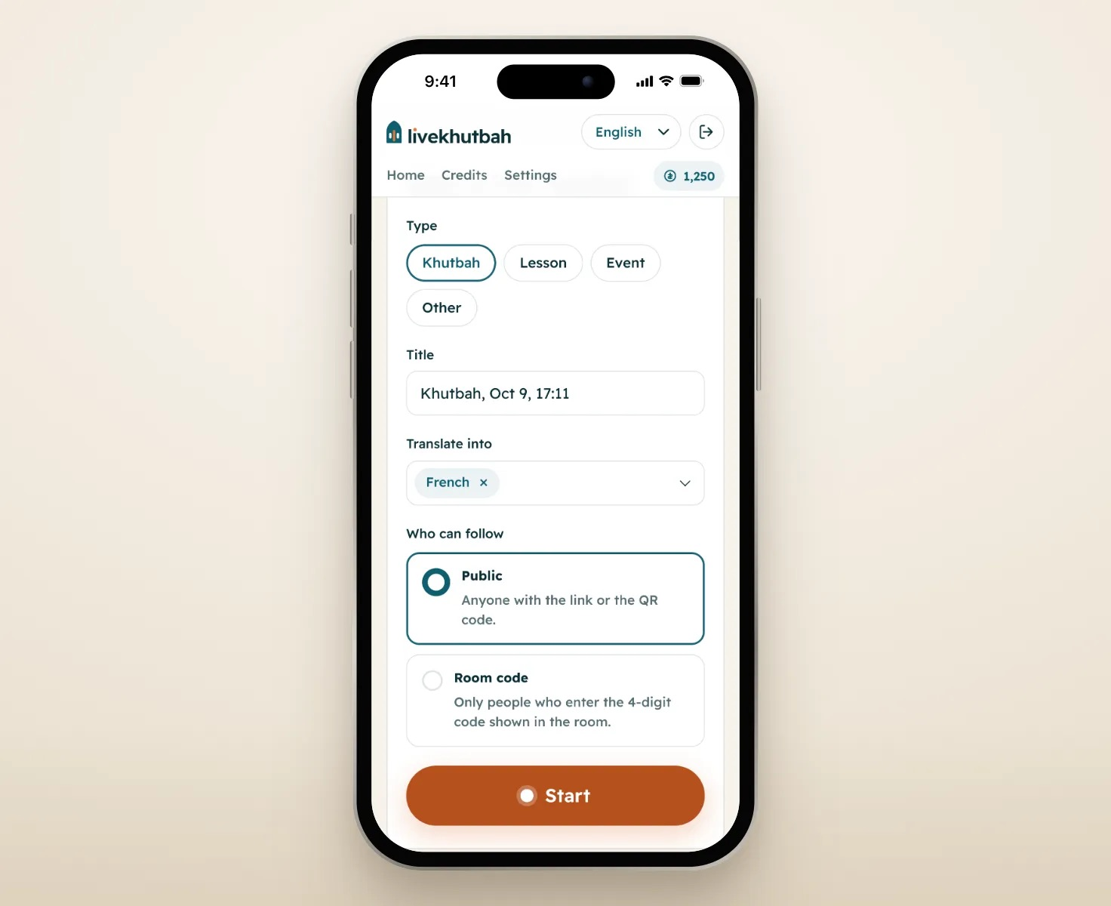
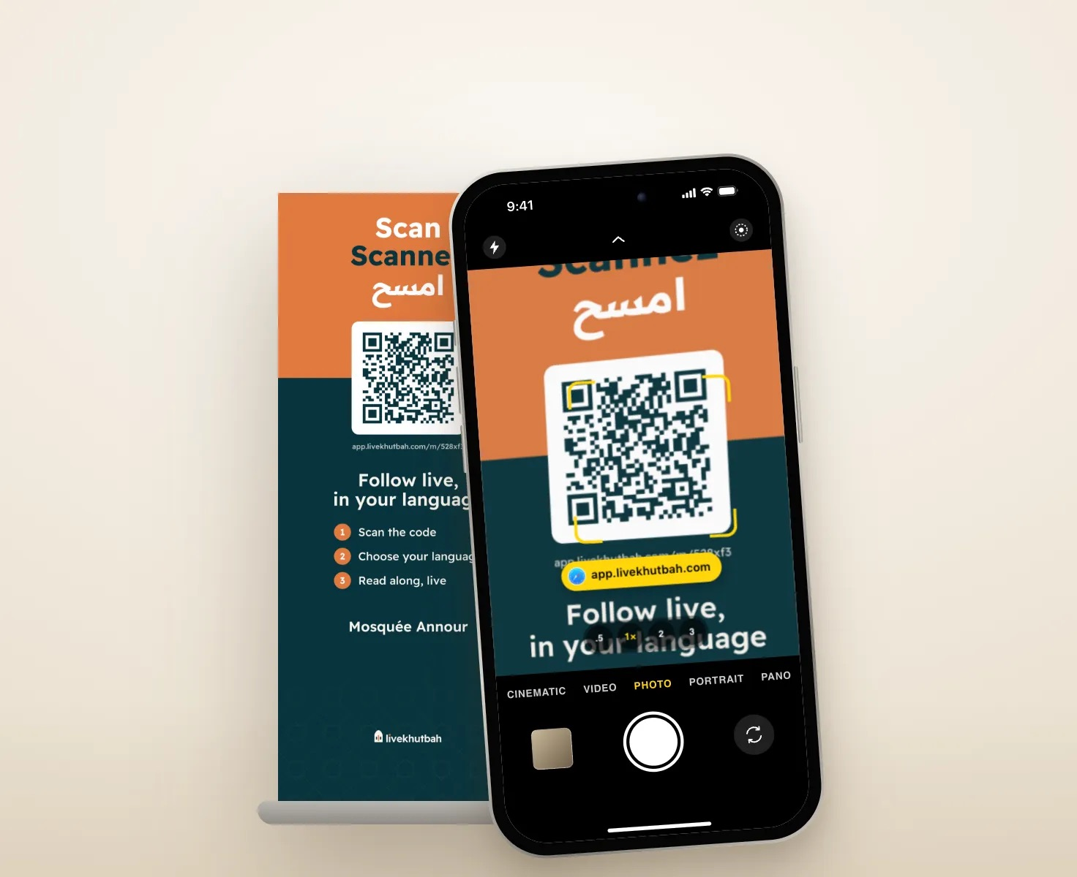
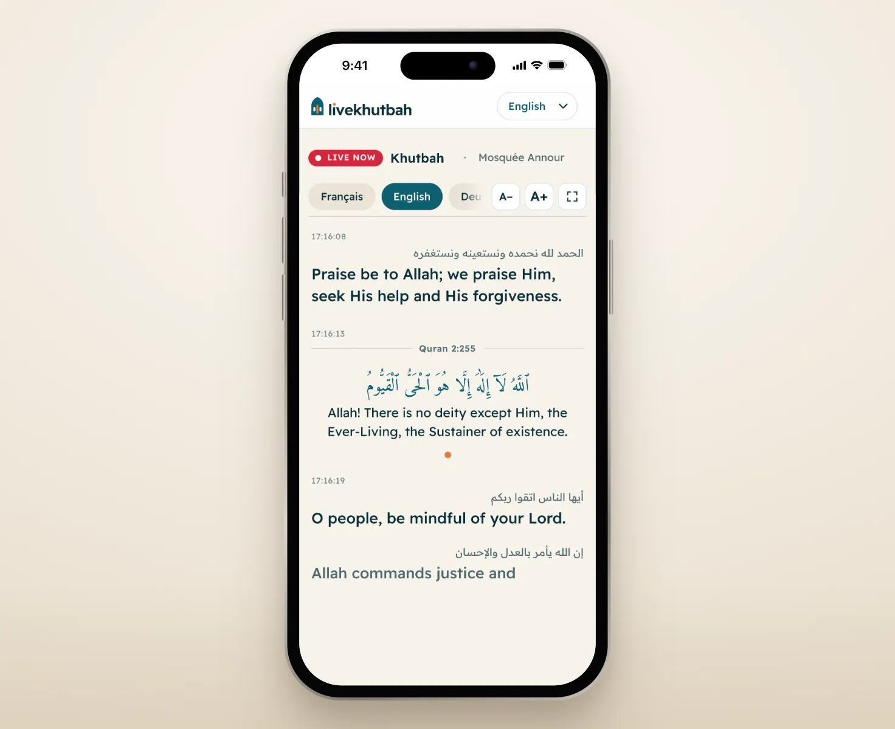
HOW IT WORKS
How the words reach everyone in the room
1. Press Go live
2. People scan your QR code
3. They follow in their language
Put a phone near the speaker with a clip-on mic, and press Go live. The app listens and translates as they speak.
Print your roll-up or show it on a screen. People scan it with their camera: no app, no account.
Each person picks their language and reads along live. You can also show it on a TV in the room.
livekhutbah.com
4

Slide 5
QURAN VERSES
When the speaker quotes the Quran, people read an approved translation
LiveKhutbah recognizes the verse and shows its Arabic text, the surah and verse number, and an approved translation of exactly the part quoted (QuranEnc.com, 44 languages). Not a machine guess.
Quran · Al-Baqarah 2:255
ٱللَّهُ لَآ إِلَٰهَ إِلَّا هُوَ ٱلْحَىُّ ٱلْقَيُّومُ
Allah, there is no deity except Him, the Ever‑Living, the Sustainer of all existence.
livekhutbah.com
5

Slide 6
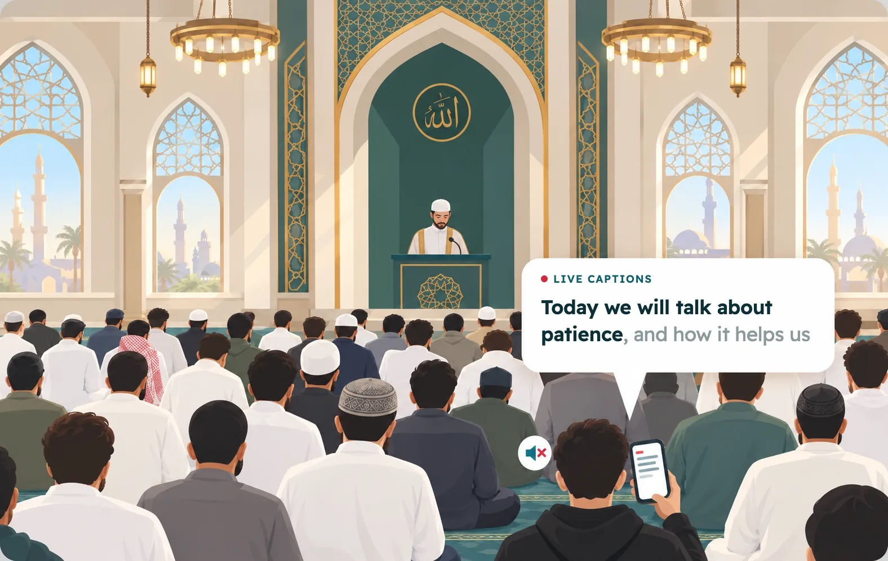
ACCESSIBILITY
Live captions for deaf and hard‑of‑hearing people
Every word appears on their phone as it is said, in the speaker’s own language or translated. They can make the text bigger, or show it full screen on a TV.
livekhutbah.com
6

Slide 7
WHO IT’S FOR
For every gathering where language is a barrier
Mosques
Schools and madrasas
Universities
The Friday khutbah, lessons, Ramadan talks.
Classes for students who speak other languages.
Lectures, seminars and conferences.
Associations and events
Converts and visitors
Deaf and hard of hearing
Meetings, conferences and community events.
Everyone who doesn’t fully understand the language spoken.
Live captions in the speaker’s own language.
livekhutbah.com
7

Slide 8

WHAT YOU NEED
A phone, a small mic, and your QR code
1
A phone or tablet near the speaker, with internet.
2
A wireless clip-on mic for the speaker. Its receiver plugs into the phone, so your sound system stays as it is.
3
Your QR code: print the ready-made roll-up or show it on a screen. Both are in the app.
4
Optional: a TV or screen in the room for the translation.
Nothing to install for the people who read along.
livekhutbah.com
8

Slide 9
PRICING
A 20-minute khutbah costs about $4
$0.20 per minute
Spark
Lantern
Lighthouse
$15 / month
$39 / month
$99 / month
1 language
$0.20
1,000 credits each month
3,000 credits each month
9,000 credits each month
2 languages
$0.30
3 languages
$0.38
Save 25%
Save 35%
Save 45%
The balance goes down per minute of speech. Silence is free. 10 credits = 1 minute of speech, for 1 language.
For mosques and non-profits, anyone, for example a member, can add credit to your balance as support or sadaqa.
livekhutbah.com
9

Slide 10
QUESTIONS
What people ask us
What do we need?
Why does the speaker wear a wireless mic?
A phone near the speaker, with an internet connection, and a wireless clip-on mic for them to wear, like the Hollyland Lark M2S (around $100). A TV is optional, because people read the translation on their own phones. If you want, you can also show it on a TV or screen in the room.
The mic sits on their collar, close to their mouth, so the phone picks up their voice over the sound of the room. Its receiver plugs into the phone, which means you can leave your sound system as it is.
How do people in the room see the translation?
Which languages can we offer?
They scan a QR code with their phone camera, from a poster at the entrance or from the TV if you have one. You can also send them a link. Nobody has to install an app or make an account.
The app can translate into more than 100 languages.
livekhutbah.com
10

Slide 11
Let everyone in the room understand
See it live now
Create your account
app.livekhutbah.com/m/demo
livekhutbah.com
Questions? Write to me
sam@livekhutbah.com
Sam, founder of LiveKhutbah

